Slide 1
FRAUD DETECTION MODEL
-By Vidhi Agarwal
IIT DELHI

Slide 2
APPROACH
Exploratory Data Analysis (EDA)
Explored the dataset to understand its structure and characteristics.
Identified and handled missing values, outliers, and data inconsistencies.
Visualized data distributions and relationships using graphs (histograms, scatter plots, etc.)
Model Development
Logistic Regression
Chosen for its simplicity and interpretability.
Trained and tuned the model to classify transactions as fraudulent or legitimate.
Decision Tree
Selected for its ability to capture non-linear patterns and interactions.
Developed and fine-tuned the model for better accuracy and interpretability.
Model Comparison
Evaluated both models using key performance metrics such as accuracy, precision, recall, and F1-score.
Compared the models to determine the best approach for fraud detection.

Slide 3
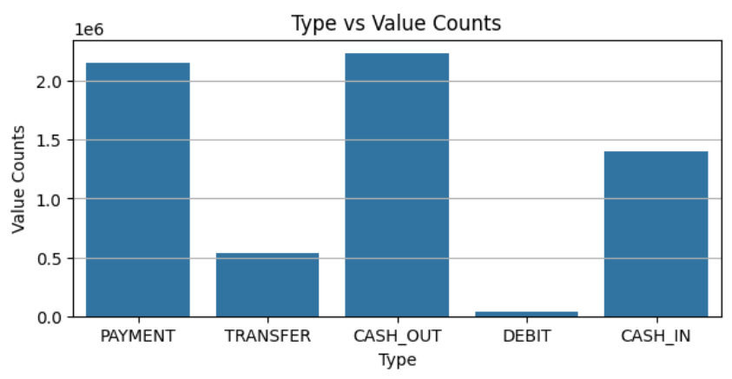
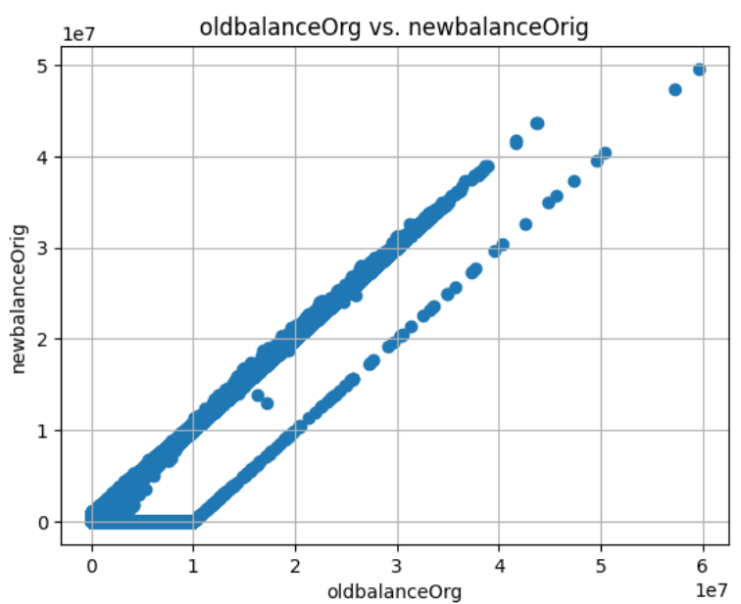
Exploratory Data Analysis (EDA)
Data Examination
Null Values: No missing values found.
Data Visualization
Transaction Types: Bar graph showing fraud detection across different transaction types.
Balance Analysis: Scatter plot of newBalanceOrg vs. oldBalanceOrg to identify patterns.
Data Pre-processing
Label Encoding: Converted categorical variables to numerical format.
Feature Selection: Removed unnecessary columns based on analysis.
Data Scaling: Applied MinMaxScaler to normalize the data.
Bar Chart
Scatter Plot

Slide 4
Model Development
Model Selection
Logistic Regression
Chosen for its simplicity, efficiency, and interpretability.
Suitable for binary classification tasks with clear probability outputs.
Decision Tree
Selected for its intuitive decision-making process and ability to handle complex datasets.
Provides easy-to-understand rules and visualization of decision paths.
Model Building
Implemented both models using appropriate libraries.
Trained models on the prepared dataset to ensure accurate fraud detection.

Slide 5
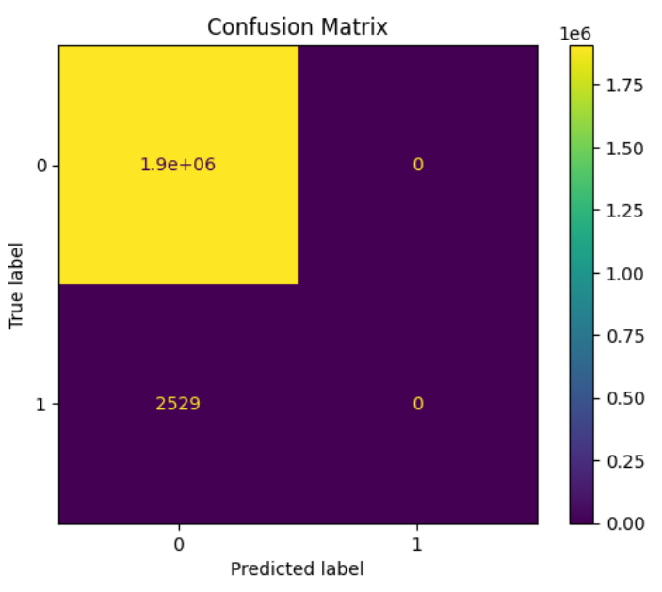
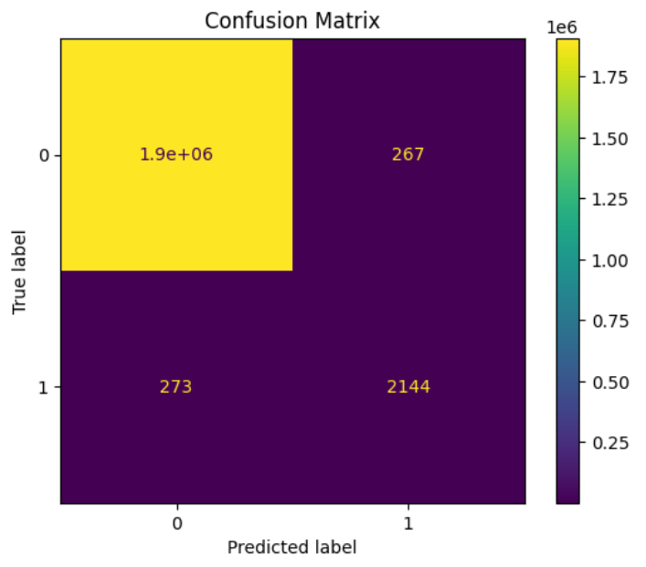
Model Comparison
Evaluation Metrics
Confusion Matrix: Used to visualize the performance of both models.
Classification Report: Provided detailed metrics including precision, recall, and F1-score.
Logistic Regression
Overall Accuracy: Very high, but misleading.
Precision and Recall for Fraud: Both were 0.
Decision Tree
Overall Accuracy: Better balance between detecting fraud and legitimate transactions.
Precision and Recall for Fraud and Legitimate Data: Both were non-zero.
Logistic Regression
Decision Tree

Slide 6
Results
Logistic Regression
Precision and Recall for Fraud: Both were 0.
Reason: Model predicted all transactions as non-fraudulent.
Impact: Due to the imbalance, accuracy was high despite poor fraud detection.
Decision Tree
Precision and Recall for Fraud and Legitimate Data: Both were non-zero.
Benefit: Model successfully identified some fraudulent transactions, improving overall reliability.

Slide 7
Conclusion and References
Conclusion
Conducted thorough Exploratory Data Analysis to understand and prepare the dataset.
Developed and compared two models: Logistic Regression and Decision Tree.
Decision Tree is the preferred model for this project due to its balanced detection capabilities.
References
https://www.geeksforgeeks.org/machine-learning/
https://www.kaggle.com/

